Slide 1
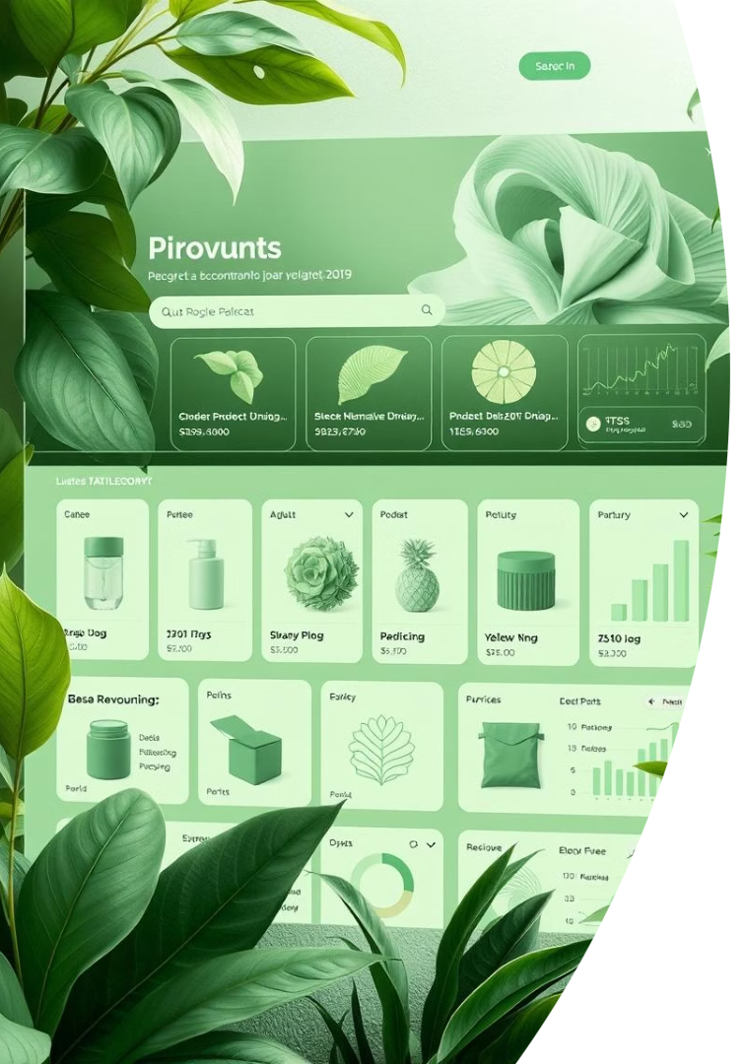
E-Commerce Product Data Science Project
Capstone Presentation
Hridhya Antony, 09/06/2025

Slide 2





Project Objective
This project aims to leverage product data for strategic business insights.
Analyze Product Data
Examine e-commerce product listings and customer interactions.
Identify Trends
Uncover market trends and customer preferences using data.
Gain Insights
Apply clustering and classification for deeper understanding.
Drive Business Value
Utilize machine learning for tangible business benefits.

Slide 3

Data Collection
Our analysis draws from comprehensive datasets to ensure rich insights.
Source
Public product datasets from Kaggle
Product Listings
50,000 listings with titles, descriptions, prices
Customer Data
20,000 reviews and ratings
Structure
Product categories and subcategories
Timeline
Listing and review dates

Slide 4
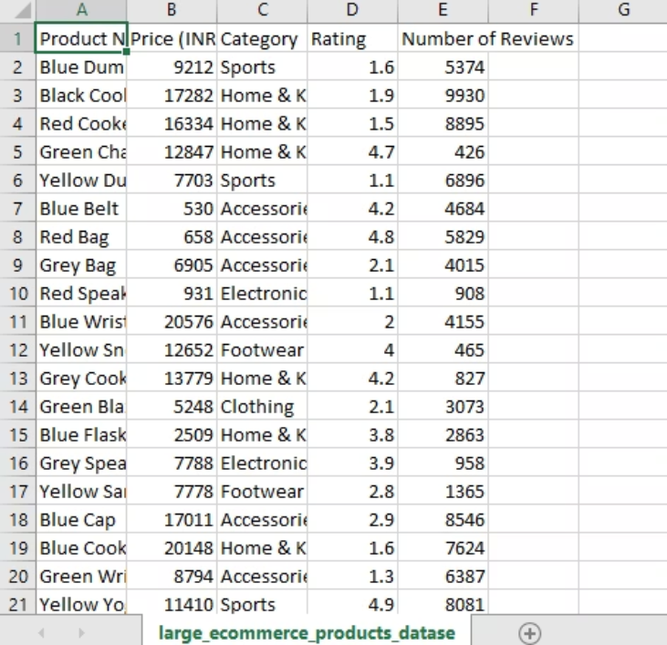
cleaned data set

Slide 5
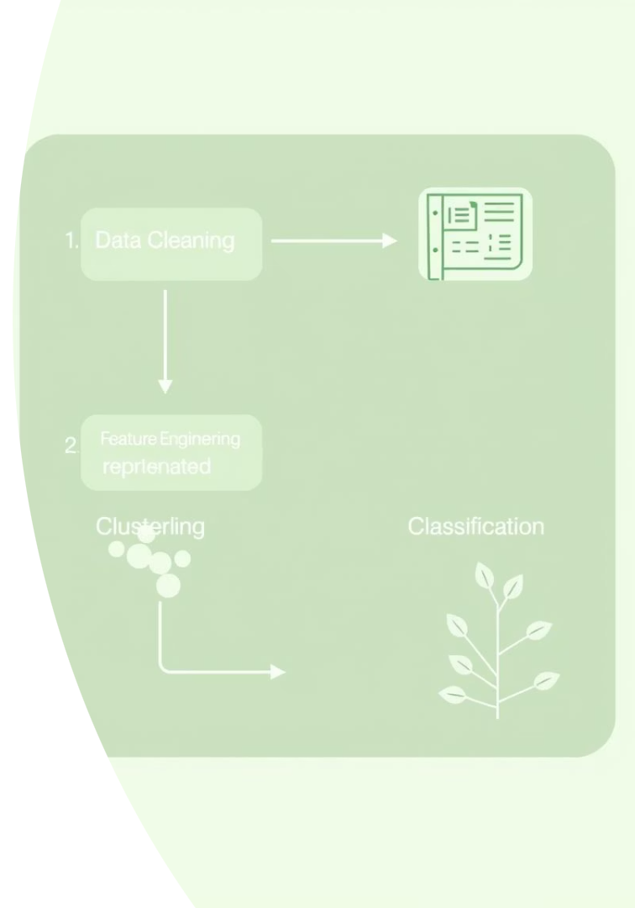




Methodology
We employed a multi-stage approach for data processing and modeling.
Data Cleaning
Handling missing values, removing duplicates for accuracy.
Feature Engineering
Extracting keywords and performing sentiment analysis.
Clustering
Using K-means for effective product segmentation.
Classification
Applying Random Forest for accurate product category prediction.

Slide 6
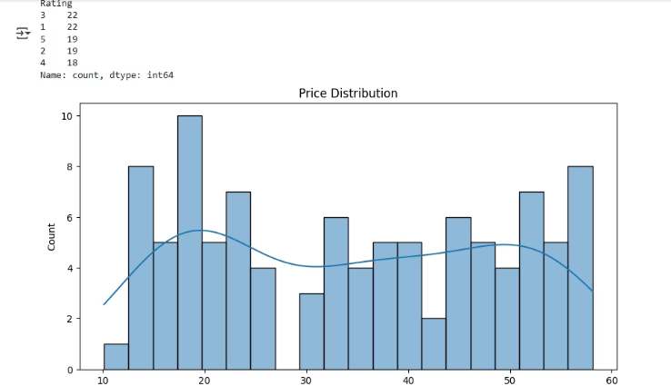
Price Distribution graph created using EDA

Slide 7
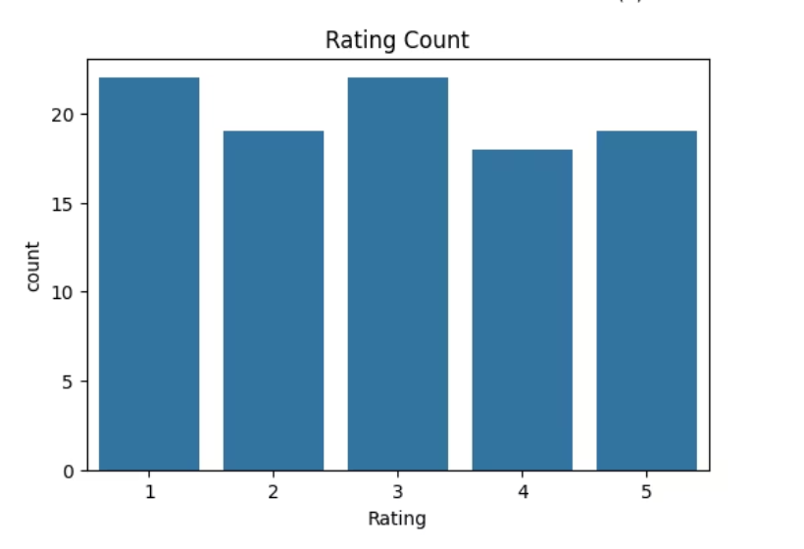

Slide 8
Results: Product Segmentation
Our clustering analysis revealed distinct product segments within the dataset.
Identified Clusters
Cluster Examples
Visualization
5 distinct product clusters found (high-end, budget, etc.).
Cluster 1: High-end electronics, average price $500+
Clusters visualized using PCA for dimensionality reduction.
Cluster 3: Budget clothing, average price under $30

Slide 9
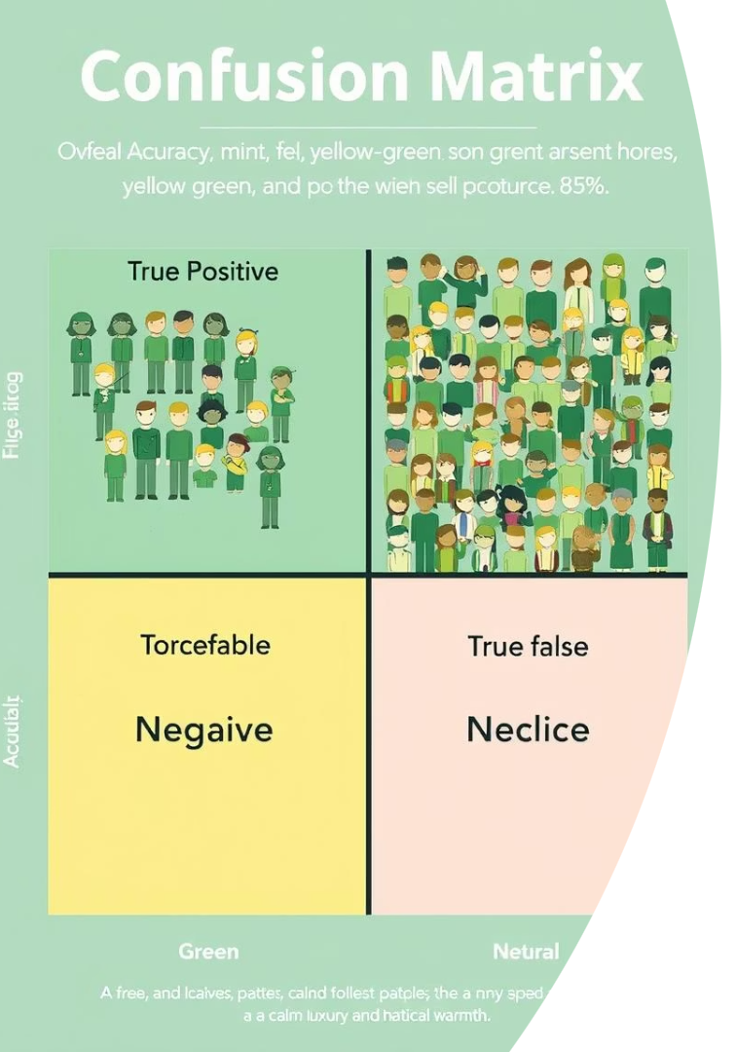
Results: Category Prediction
The Random Forest model demonstrated strong performance in predicting product categories.
85%
Accuracy
Random Forest model achieved 85% accuracy.
10%
Improvement
Accuracy improved by 10% with hyperparameter optimization.
Top features driving prediction were product description keywords and brand name.

Slide 10

Business Value
The project's insights offer significant opportunities for business growth and efficiency.
Targeted Marketing
Personalized Recommendations
Improved Categorization
Launch campaigns based on product clusters for better engagement.
Enhance search results through precise product categorization.
Offer tailored product suggestions to individual customers.
These applications hold the potential to increase sales by 15%.

Slide 11
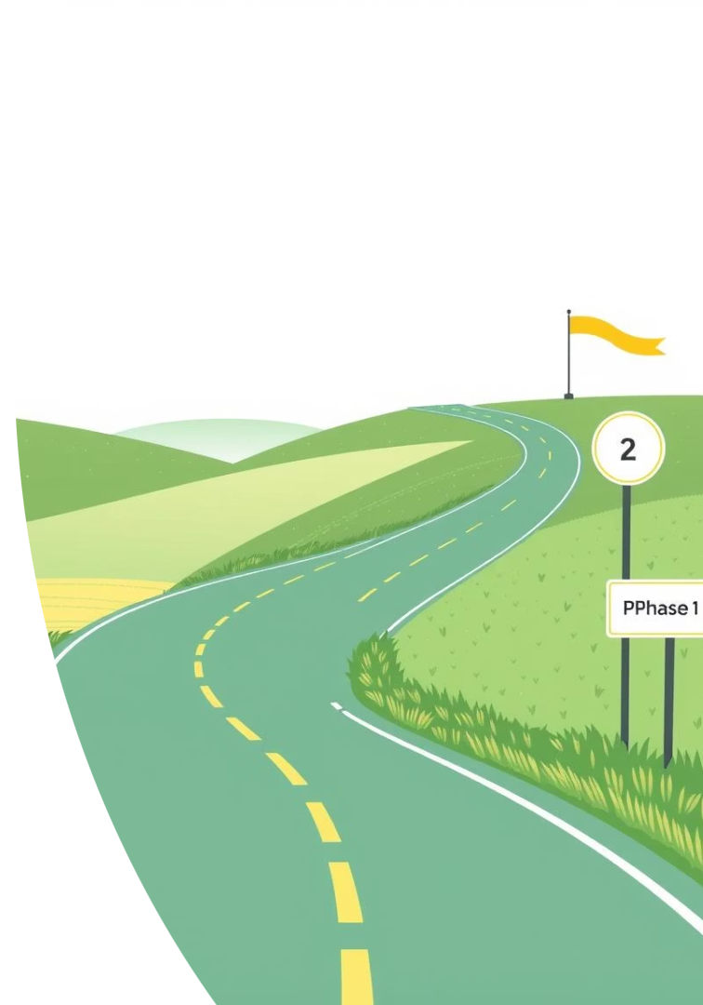
Future Work
Our next steps involve expanding data sources and enhancing real-time capabilities.
Integrate More Data
Incorporate social media and web traffic data for richer context.
Real-time Recommendations
Develop a system for instant, dynamic product suggestions.
Competitor Analysis
Expand analysis to include competitor product data for market insights.

